Slide 1
Welcome to Our Presentation

Slide 2
Group Member
NAME | ID
ROBIUL ISLAM ROMAN | 22-46490-1
TRIDIB SARKAR | 22-46444-1
MAHMUDUS SAMI MAAHI | 22-46446-1
ABDULLAH AL ANJUM ARIAN | 22-47637-2
SHISHIR MAHMUD | 22-47683-2

Slide 3


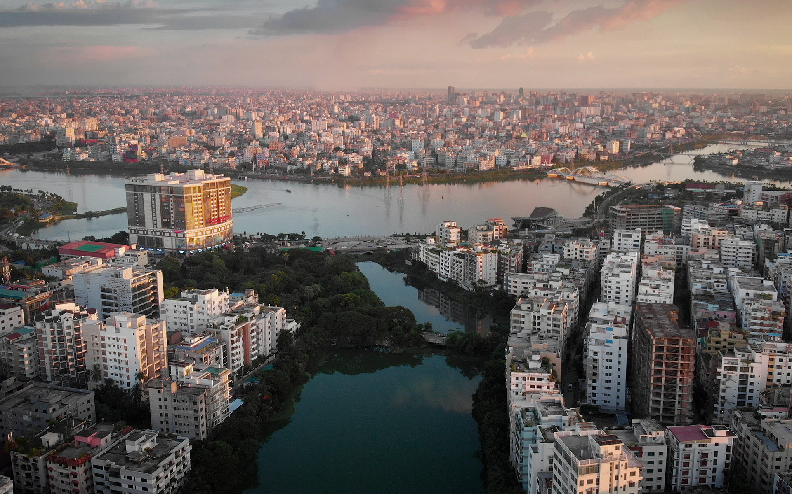

Bangladesh study
DEMOCRACY AND POLITICAL CULTURE OF BANGLADESH

Slide 4

ABSTRACT
The political culture school argues that the values, beliefs, and skills of mass publics have an important impact on politics in general and on democratic institutions. The chapter analyzes data from World Values Surveys/European Values Surveys and finds that mass attitudes are correlated with the actual presence or absence of democracy at the societal level, but the effectiveness of given items varies a good deal, and many of them are relatively weak predictors. It demonstrates that economic development does tend to bring changes in culture and social structure that make the emergence and survival of democracy more likely. The correlations between mass attitudes and democracy are systematically higher when one use the longer period because political culture is a better predictor of the long-term stability of democracy than it is of a society's level of democracy at any given point in time.

Slide 5
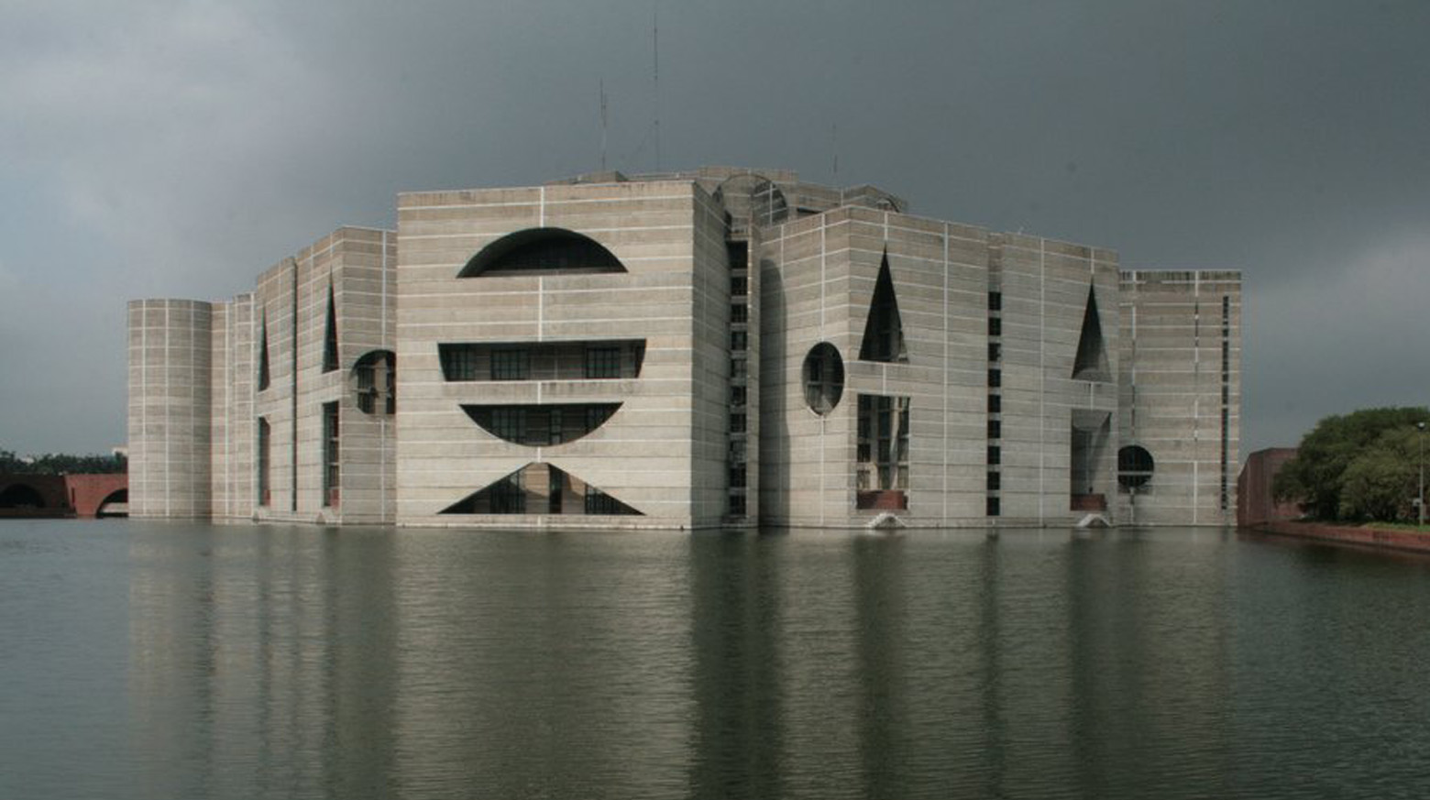
Politics of Bangladesh takes place in a framework of a parliamentary representative democratic republic, whereby the Prime Minister of Bangladesh is the head of government, and of a multi-party system. Executive power is exercised by the government. Legislative power is vested in both the government and parliament. The Constitution of Bangladesh was written in 1972 and has undergone seventeen amendments.
Journey of Bangladesh Politics

Slide 6
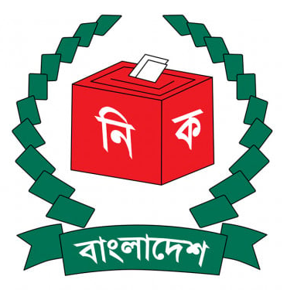
Political parties and elections
Bangladesh Awami League Party (AL)
Bangladesh Nationalist Party (BNP)
Jatiya Party (Hussain Muhammad Ershad)
Bangladesh Jamaat-e-Islami

Slide 7

1970 Pakistani National Assembly election
Party | Votes | % | Seats
Awami League | 12,338,921 | 74.9 | 160
Jamaat-e-Islami | 991,908 | 6.0 | 0
PPP | 483,571 | 2.9 | 1
Pakistan Muslim League (Convention) | 464,185 | 2.8 | 0
National Awami Party (Wali) | 310,986 | 1.8 | 0
Pakistan Muslim League (Kou) | 274,453 | 1.6 | 0
Pakistan Muslim League (Kayum) | 175,822 | 1.0 | 0
Independent | 561,083 | 3.4 | 1

Slide 8





Provisional Government

Slide 9
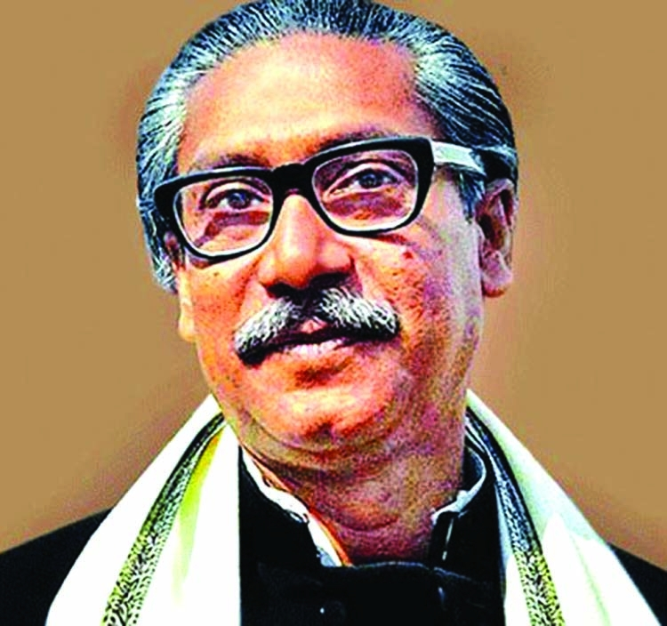
Sheikh Mujibur Rahman, (1972-75)
Sheikh Mujibur Rahman came to administrative centre with immense personal popularity but had difficulty transforming this popular support into the political strength needed to function as head of government. The 1972 constitution adopted as state policy the Awami League's (AL) four basic principles of nationalism, secularism, socialism, and democracy.

Slide 10
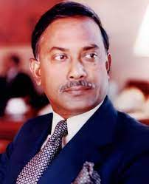
Ziaur Rahman, (1975-81)
Successive military coups resulted in the emergence of Army Chief of Staff General Ziaur Rahman ("Zia") as strongman. He pledged the army's support to the civilian government headed by President Chief Justice Sayem. (Background Note, 2008).Acting at Zia's behest, Sayem dissolved Parliament, promising fresh elections in 1977, and instituted martial law. (Background Note, 2008). Lifting the ban on political parties from Mujib's one party BAKSAL rule, he sought to revitalize the demoralized bureaucracy, to begin new economic development programs, infrastructure build up, a free press and to emphasize family planning.

Slide 11
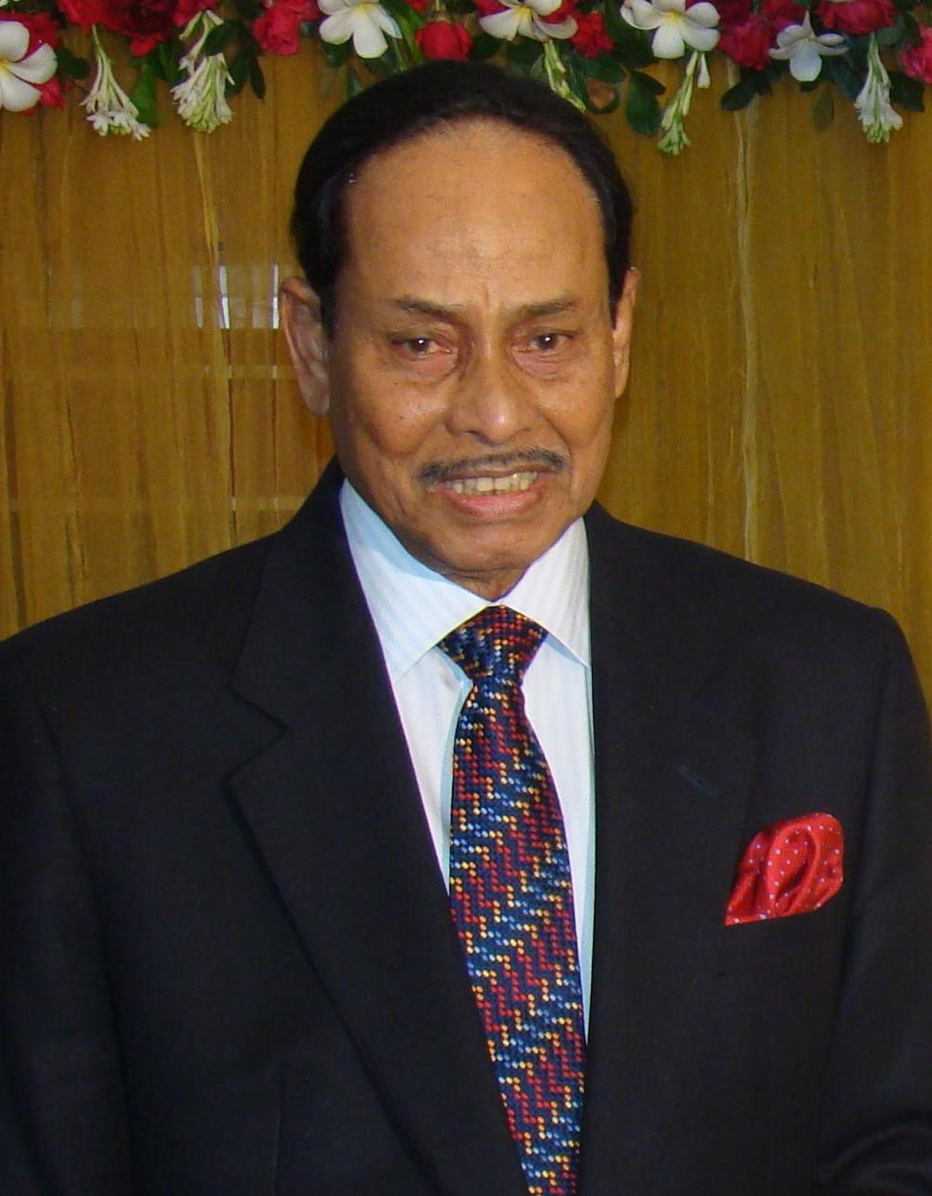
Hussain Mohammed Ershad (1982-1990)
Army Chief of Staff Lt. Gen. Hussain Mohammed Ershad assumed power in the second, but, bloodless coup in March 24th 1982. To strengthen his hold on government Ershad suspended the constitution and citing pervasive corruption, ineffectual government, and economic mismanagement declared martial law

Slide 12
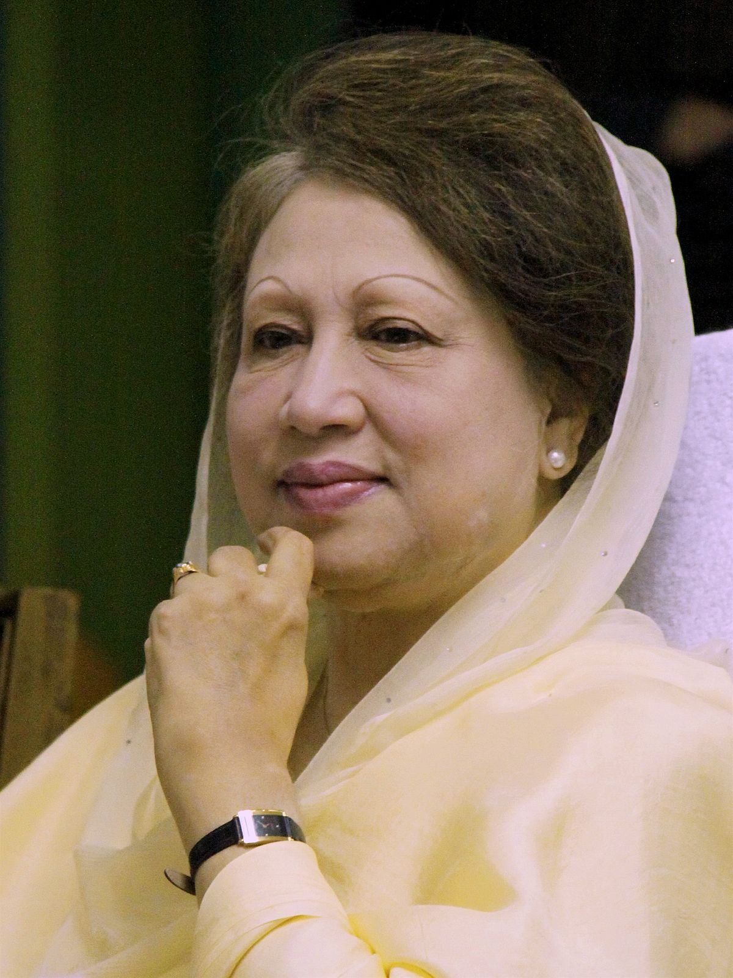
Khaleda Zia, (1991-96)
The centre-right BNP won a plurality of seats and formed a government with support from the Islamic party Jamaat-I-Islami, with Khaleda Zia, widow of Ziaur Rahman, obtaining the post of prime minister. In March 1994, controversy over a parliamentary by-election, which the opposition claimed the government had rigged, led to an indefinite boycott of Parliament by the entire opposition. The opposition also began a program of repeated general strikes to press its demand that Khaleda Zia's government resign and a caretaker government supervise a general election.

Slide 13
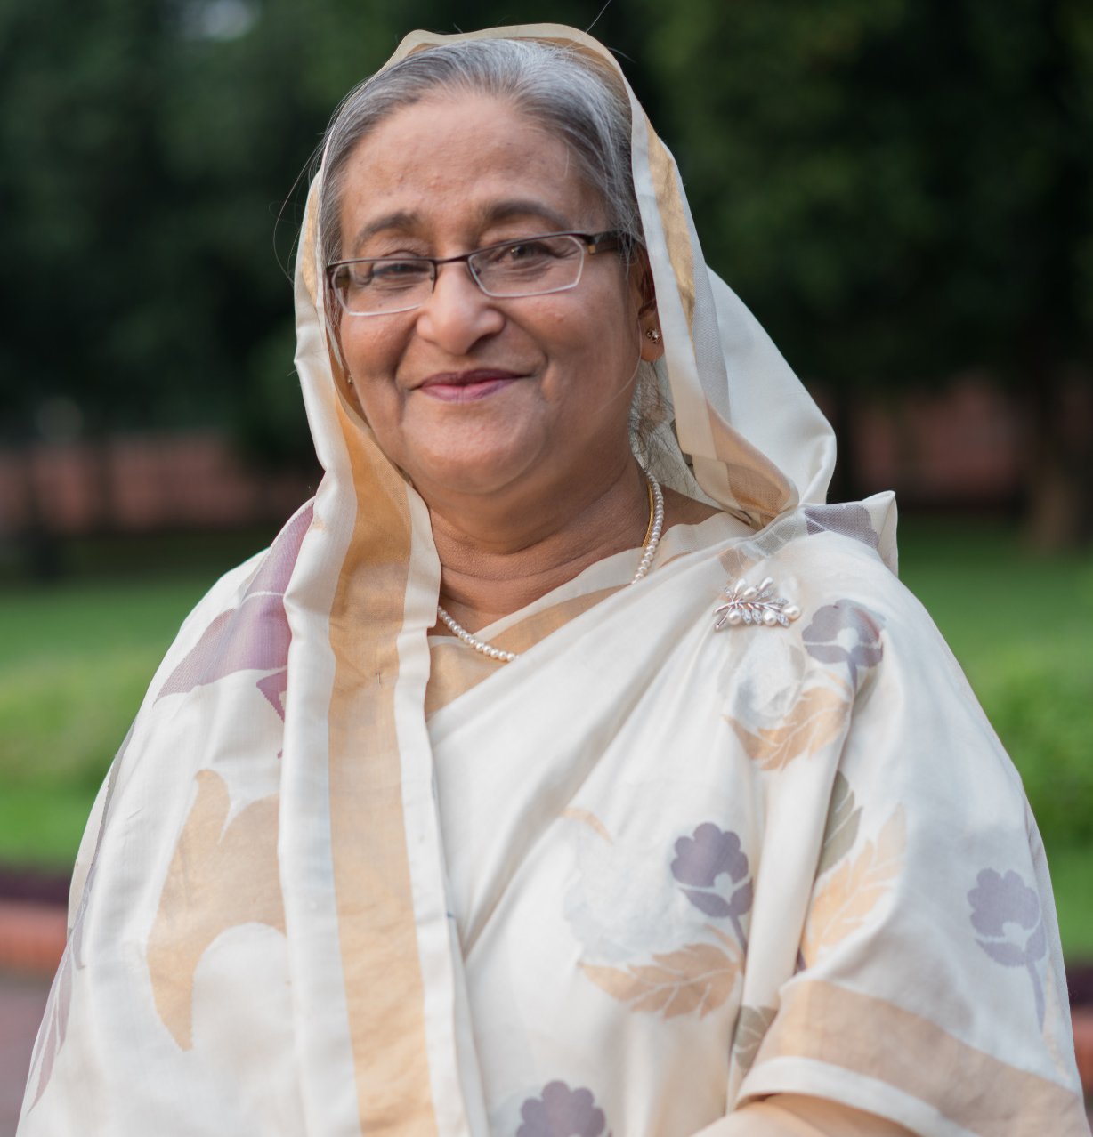
Sheikh Hasina, (1996-2001)
Sheikh Hasina, (1996-2001)
Sheikh Hasina formed what she called a "Government of National Consensus" in June 1996, which included one minister from the Jatiya Party and another from the Jatiyo Samajtantric Dal, a very small leftist party.The Jatiya Party never entered into a formal coalition arrangement, and party president H.M. Ershad withdrew his support from the government in September 1997. (Background Note, 2008). International and domestic election observers found the June 1996 election free and fair, and ultimately, the BNP party decided to join the new Parliament.
Sheikh Hasina formed what she called a "Government of National Consensus" in June 1996, which included one minister from the Jatiya Party and another from the Jatiyo Samajtantric Dal, a very small leftist party.The Jatiya Party never entered into a formal coalition arrangement, and party president H.M. Ershad withdrew his support from the government in September 1997. (Background Note, 2008). International and domestic election observers found the June 1996 election free and fair, and ultimately, the BNP party decided to join the new Parliament.

Slide 14
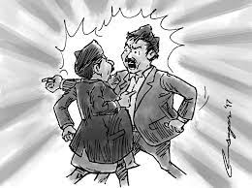
Inter and Intra-Party Conflict Resolution in Bangladesh
The politics of vengeance always comes in our country. Everyday people are being killed in the fire of this political vendetta. People are living in fear. Feeling insecure in your own house. The only reason for this situation is that there is no equal rights politics in the country. Political parties have no respect. There is no national leader by whom the general people will call together or to assist the government. This national leader cannot be created because there is no friendly politics after independence, there is no politics of respect for each other.

Slide 15

Conclusion
Political culture is trans-mitted from one generation to another by socialization, a process in which the individual, through many experiences with parents, friends, teachers, political leaders, and others, learns politically relevant values, beliefs, and attitudes. Political culture, then, is acquired by the individual, becomes a part of his or her psychological makeup, and is manifested in his or her behavior.

Slide 16
Thanks

